Slide 1



Team Members
C191085: Mohammad Fahad Faisal
C191089: Emon Dhar
C191101: Sayed Tashinoor Rahman

Slide 2

Library Management System
Database Project

Slide 3
Short Brief on Library Management System
A simple Library Management System which allows us to add new Students, add new books, issue books to specific students and return books. Also, we can check activity of borrowing books and returning books. And we can search for students by ID, Name, course and department. Also we can search for books by ID , Name,
Publisher, price and Published Year. We can get the transaction log of borrowing books and returning books of
Specific student and specific book.
We used java with NetBeans and ORACLE Database for the project.
Here we used Three Table STUDENT, BOOK, ISSUE. We used INSERT , CREATE, UPDATE, SELECT, INNER JOIN, LEFT OUTER JOIN ,RIGHT OUTER JOIN in various ways and also in used some SUB-QUERY.

Slide 4
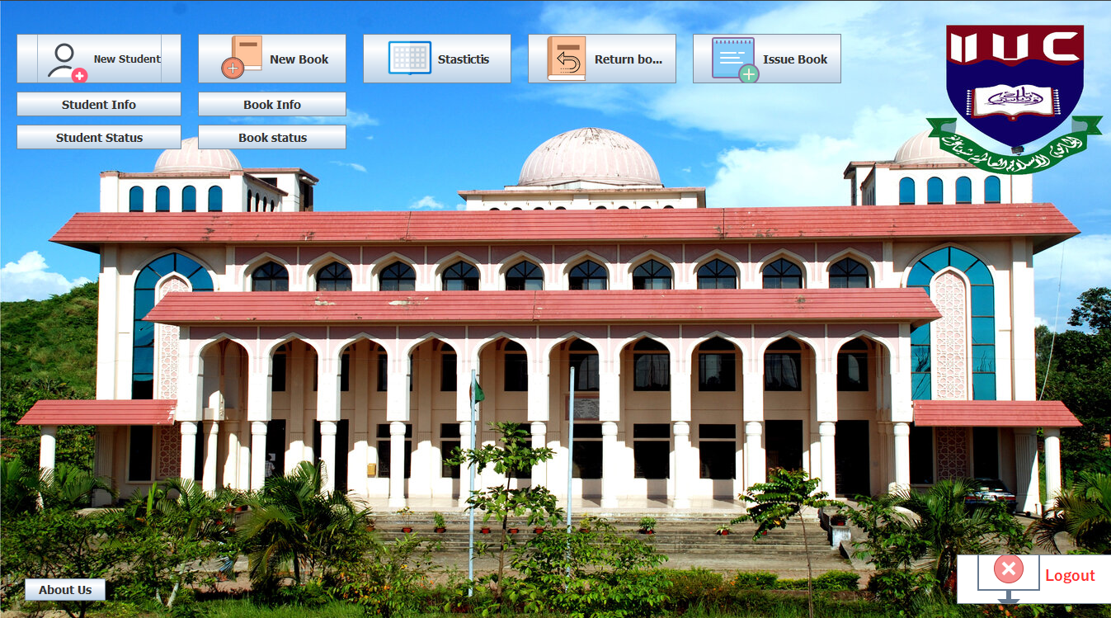
MAIN MENU
Here we have 10 options’:
1.New Students: adds new students into STUDENTS database Table.
2.New Books: adds new books into BOOKS database Table.
3.Statistics: show statistics of issue books and return books in two different table view.
4.Return Books: Return books, From ISSUE database Table.
5.Iusse Books: Issue books to ISSUE Database table.
6.Student info: here we can search for student’s by their ID, NAME, course Name, Department Name.
7.Student Status: We can get the transaction log of borrowing books and returning books of Specific student .
8.Book info: we can search for Books by ID, Name, Publisher, Price, Publisher year.
9.Book Status: We can get the transaction log of borrowing books and returning books of Specific Boos.
10.Logout: logout from software.

Slide 5
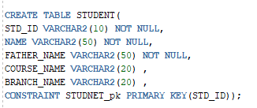
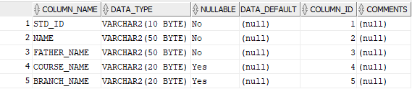
CREATE statement for STUDENT table

Slide 6
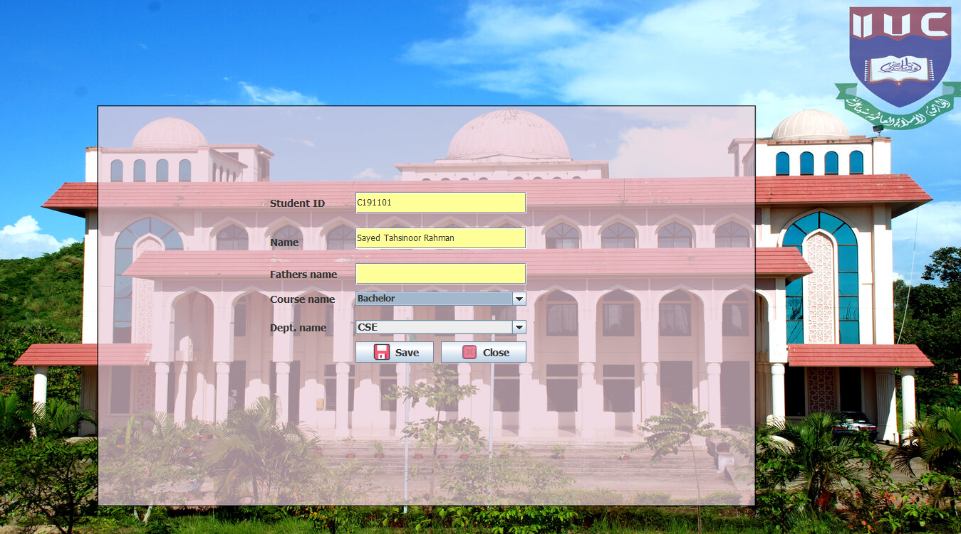
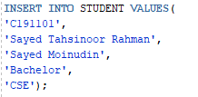
Add new Student
INSERTing values in STUDENT Table

Slide 7
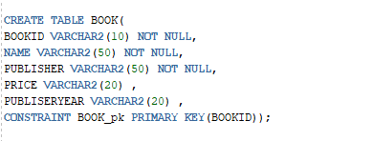
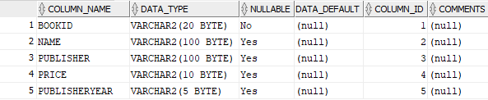
CREATE statement for BOOK table

Slide 8
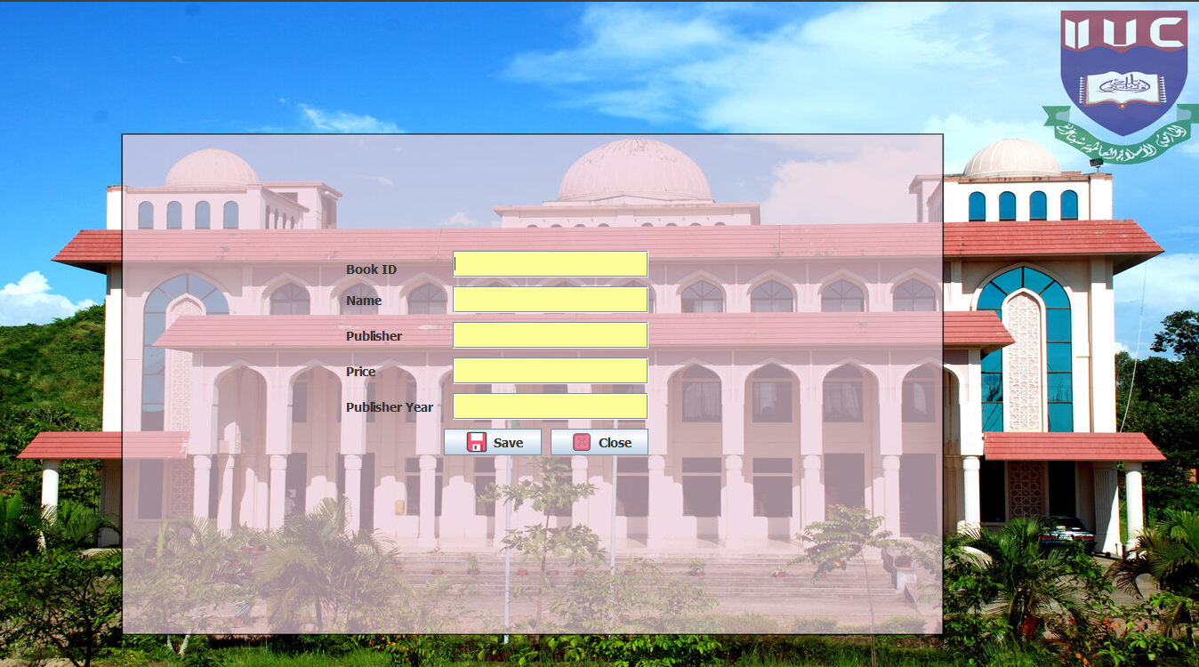
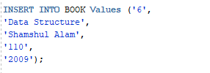
Add new book
Inserting values in BOOK Table

Slide 9
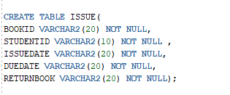
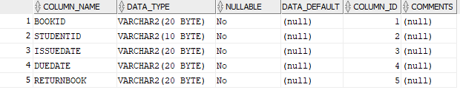
CREATE statement for ISSUE table

Slide 10
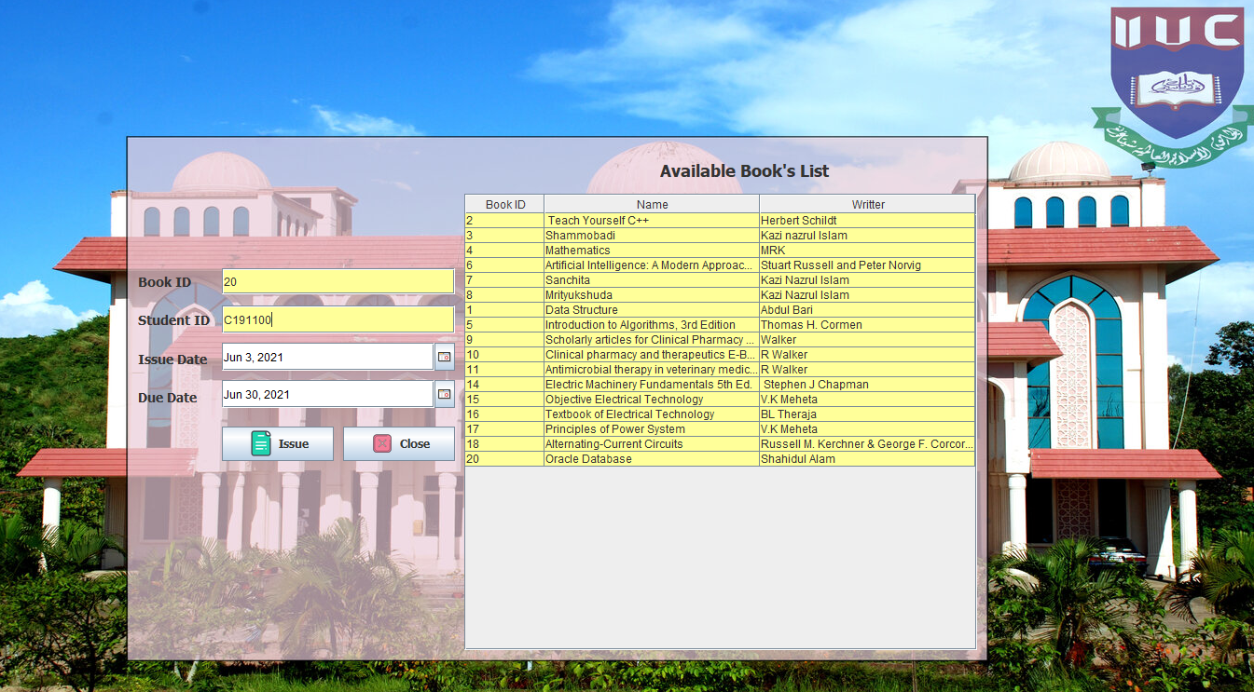
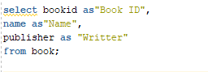
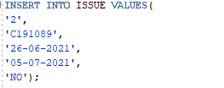
Issue a Book to a specific Student
Here first we will show a list of available book
Inserting value into our ISSUE Table

Slide 11
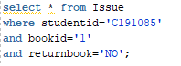
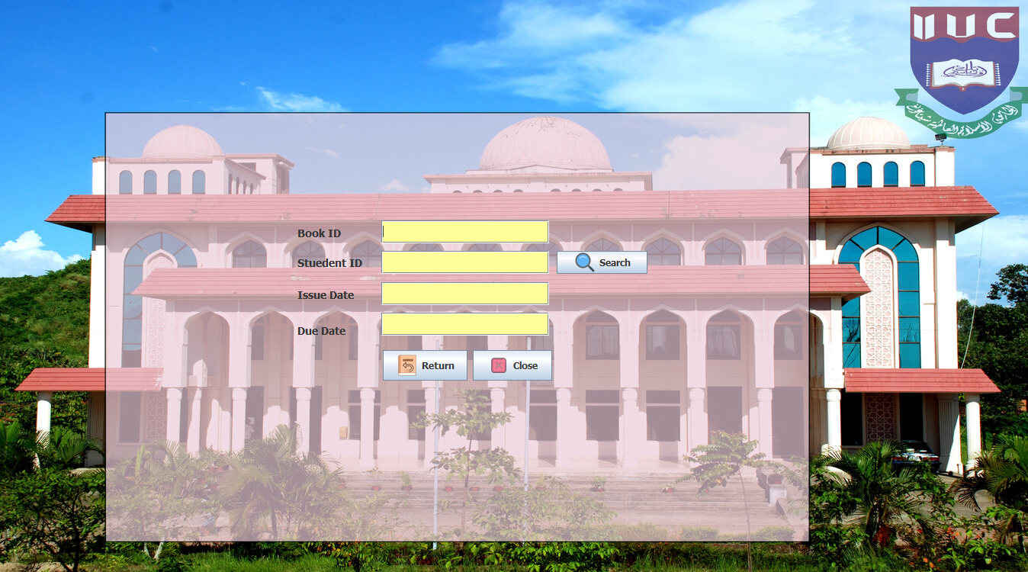
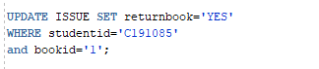
Returning Book
After getting bookid and studentid we search through the ISSUE Table for that bookid and studentid which has not returned the book yet.
Then UPDATE the returnbook column to YES.

Slide 12
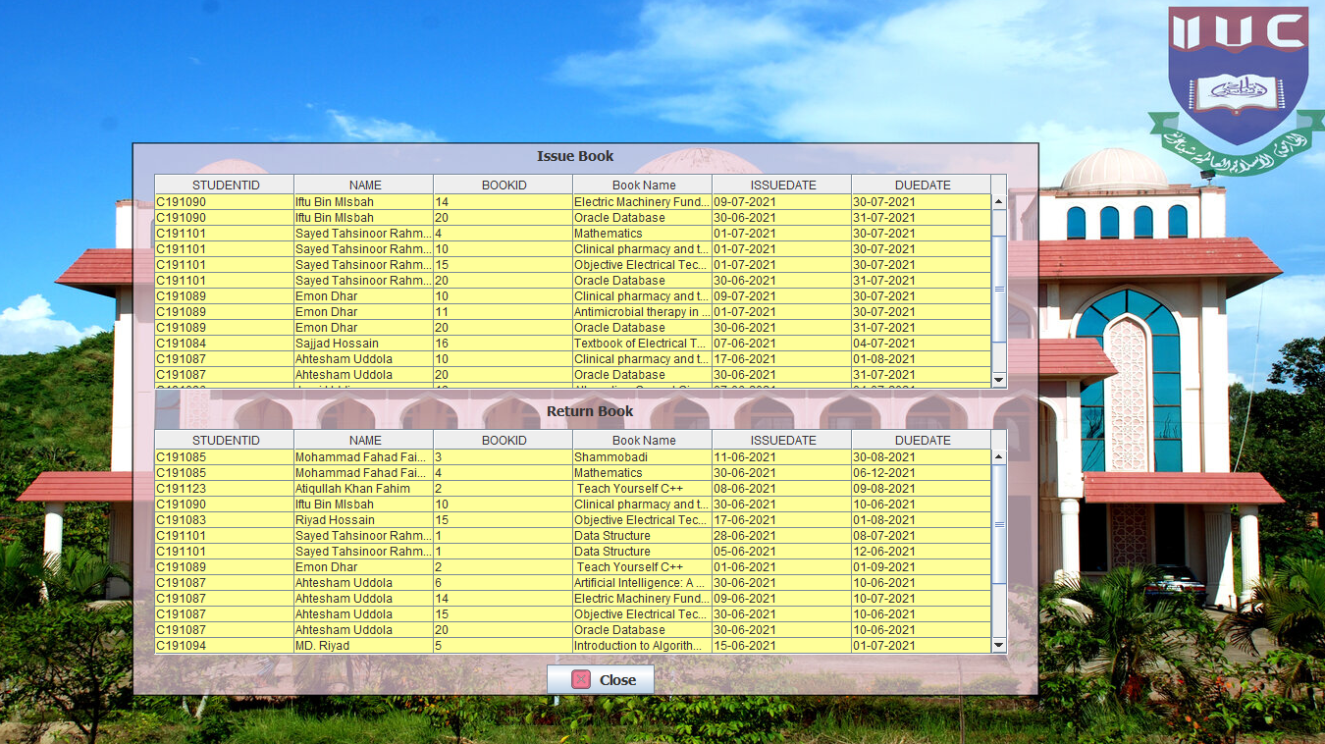
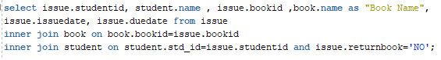
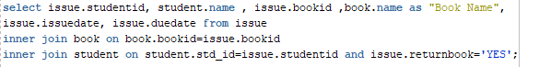
Statistics of Book issue and Return
In the Issue book table, we INNER JOIN d three table STUDENT BOOK ISSUE With bookid and studentid where book has not returned yet.
In the Issue book table, we INNER JOIN d three table STUDENT BOOK ISSUE With bookid and studentid where book has been returned.

Slide 13
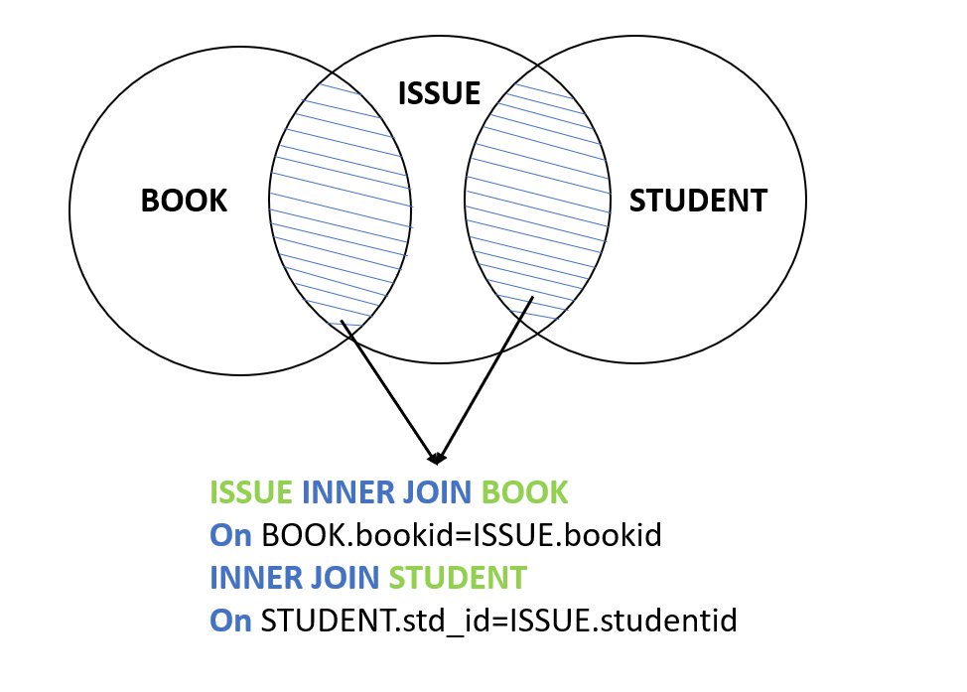

Slide 14
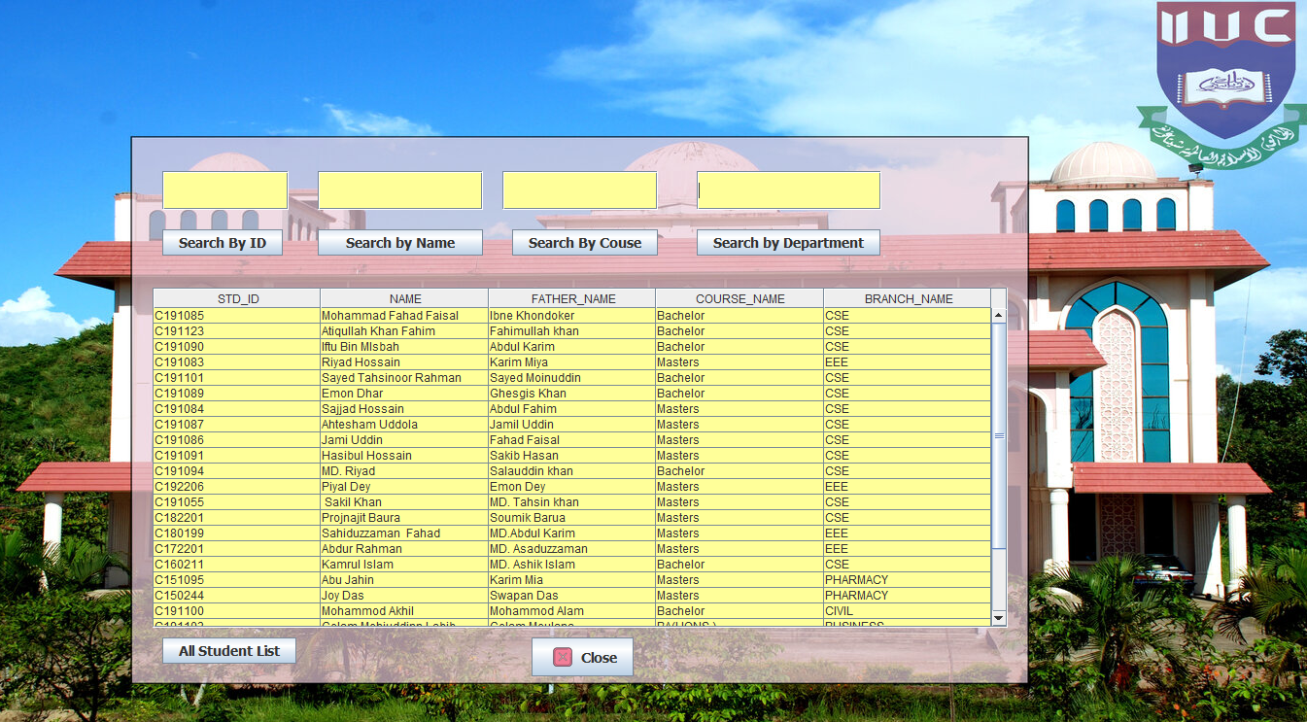
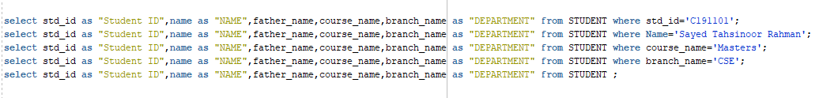
Showing Student Info
Here we can search students by ID , NAME , COURSE , DEPARTMENT
Also we can see All students list.

Slide 15
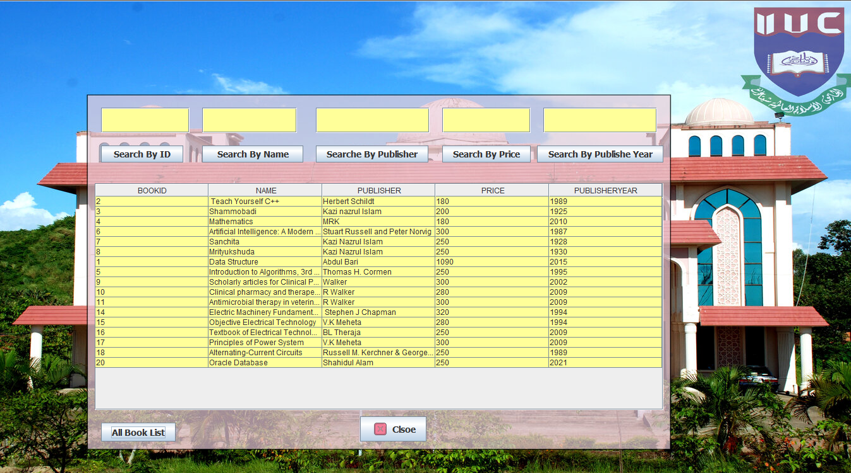
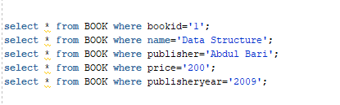
Showing BOOK Info
Here we can search books by ID , NAME , PUBLISHER , PRICE , PUBLISHED_YEAR
Also we can see All books list.

Slide 16
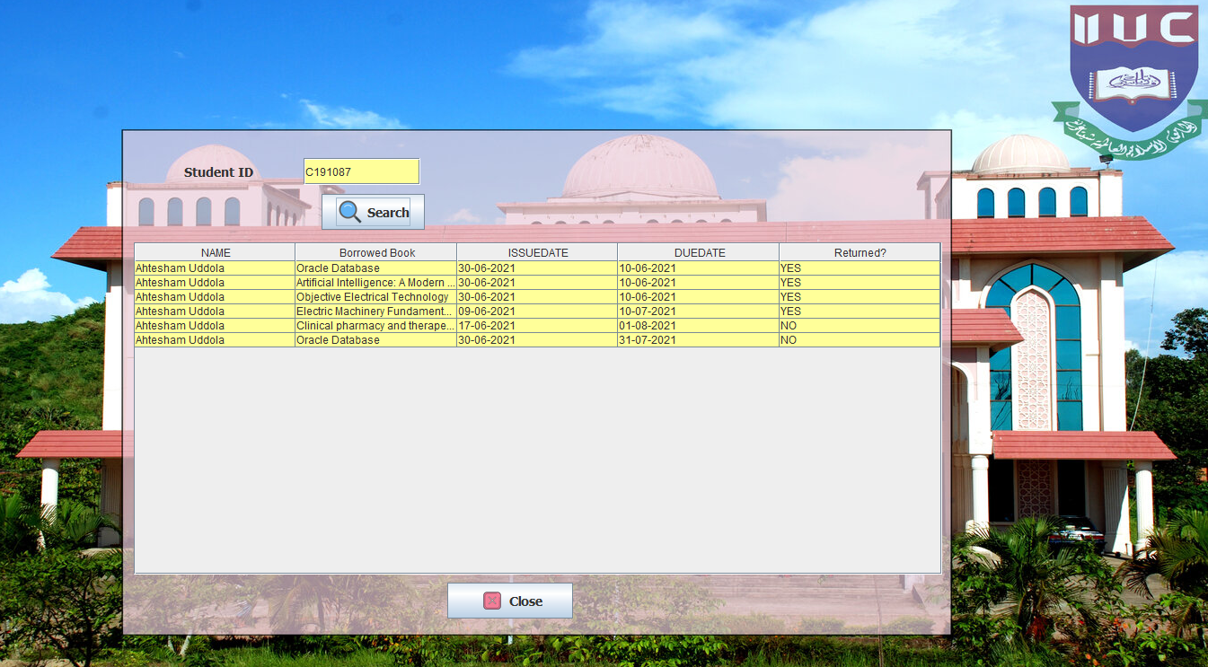
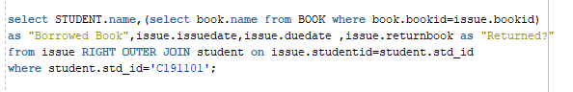
Showing STUDENT status
Here we can see the activity of borrowing and return books of a specific student by RIGHT OUTER JOIN ISSUE and STUDENT table

Slide 17
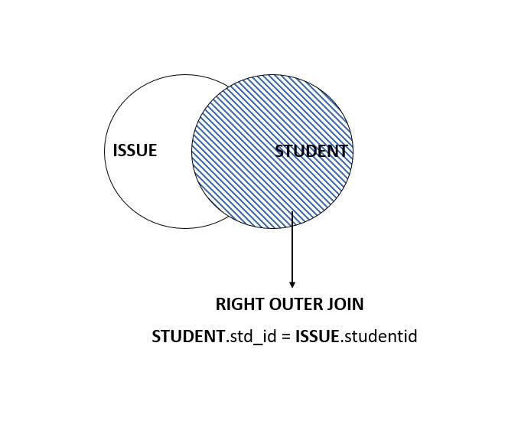

Slide 18
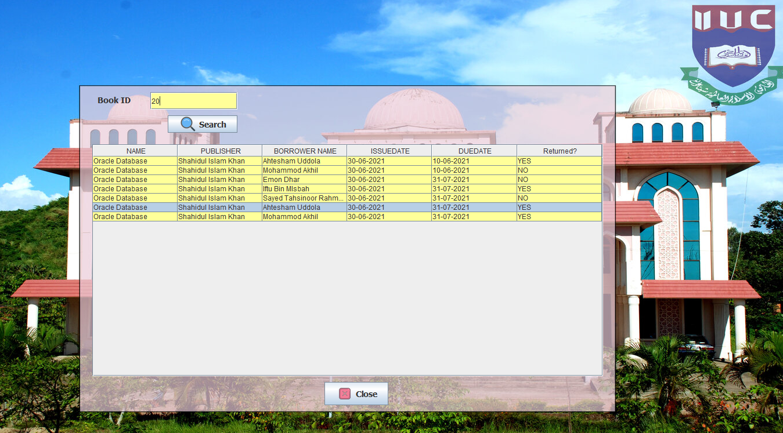
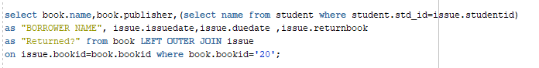
Showing BOOK status
Here we can see the activity of borrowing and return books of a specific book by LEFT OUTER JOIN BOOK and ISSUE table

Slide 19
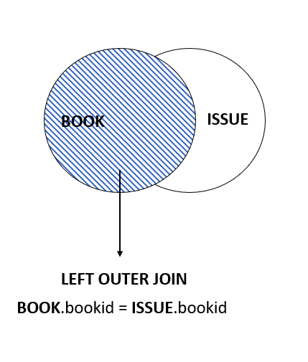

Slide 20
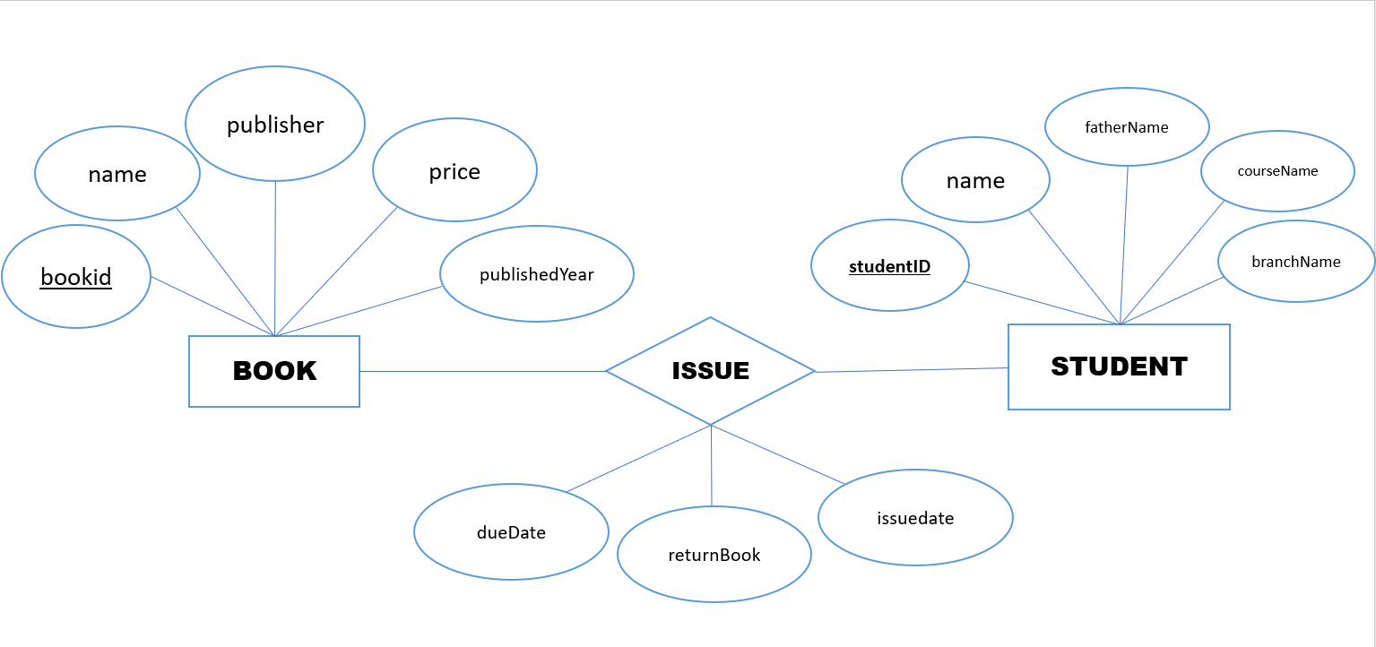

Slide 21
Assalamualaikum
THANK YOU

